Slide 1
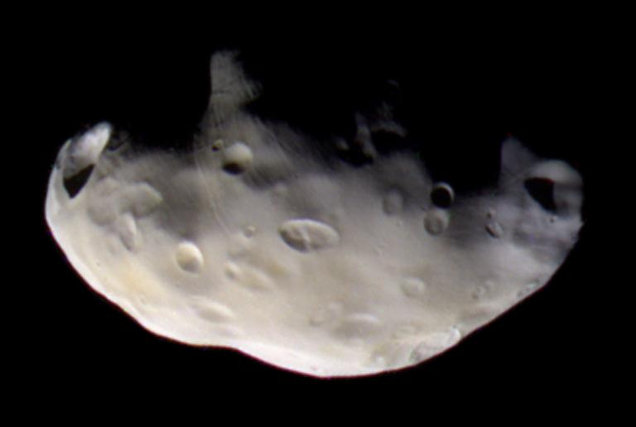
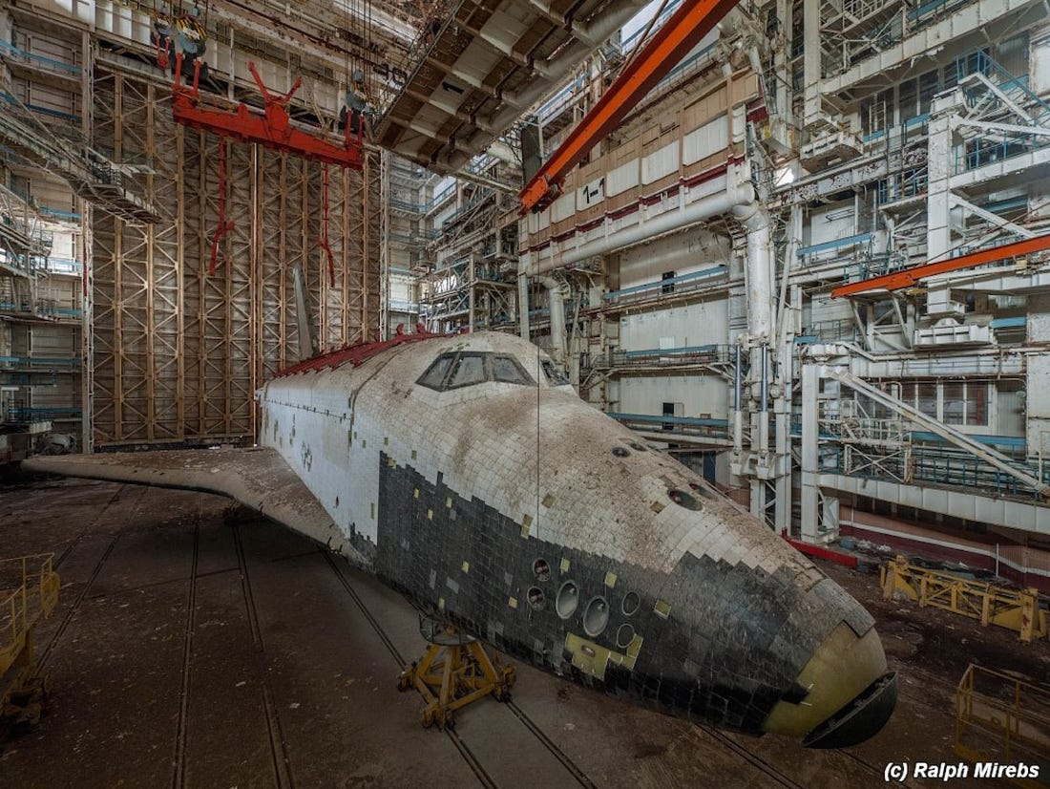
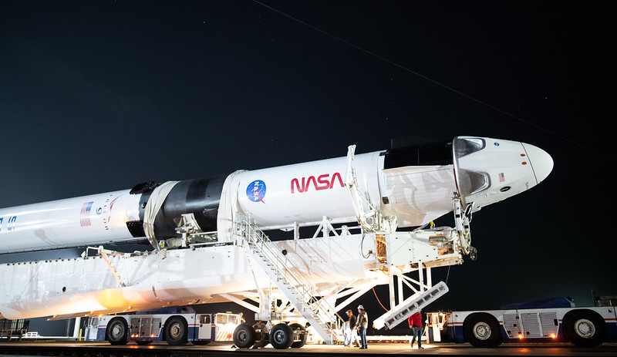
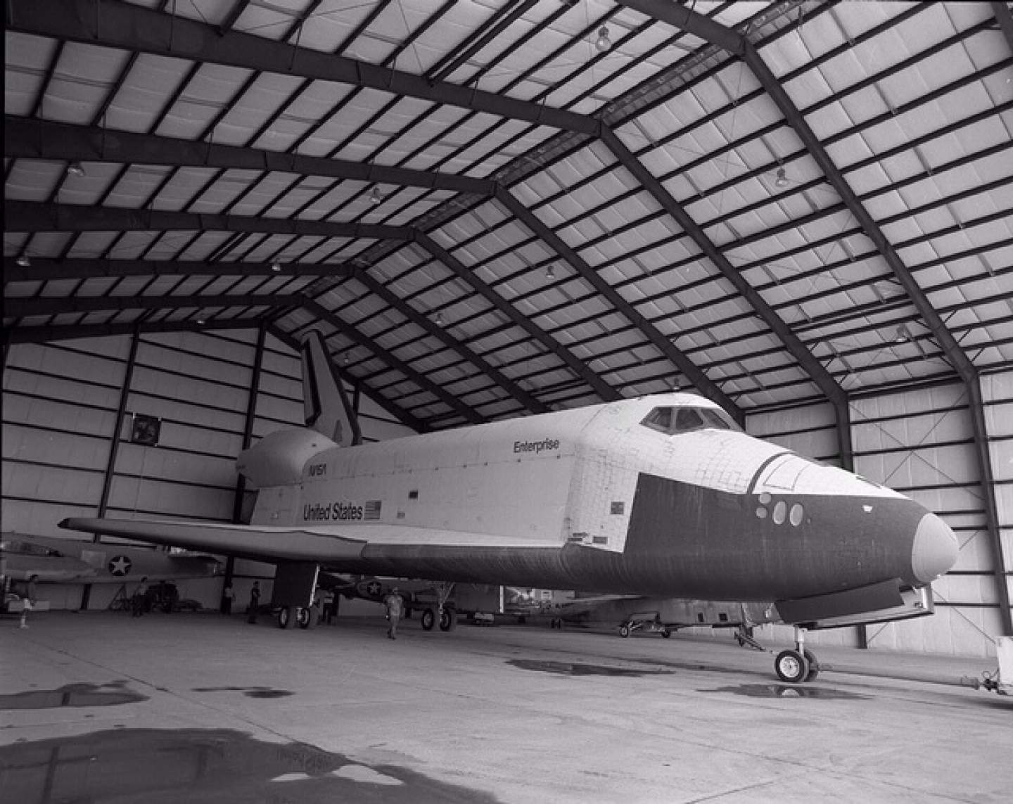
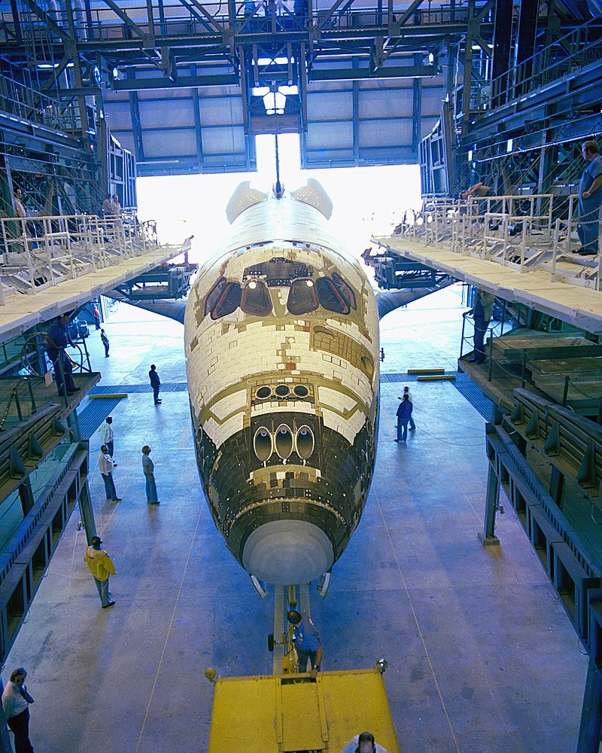
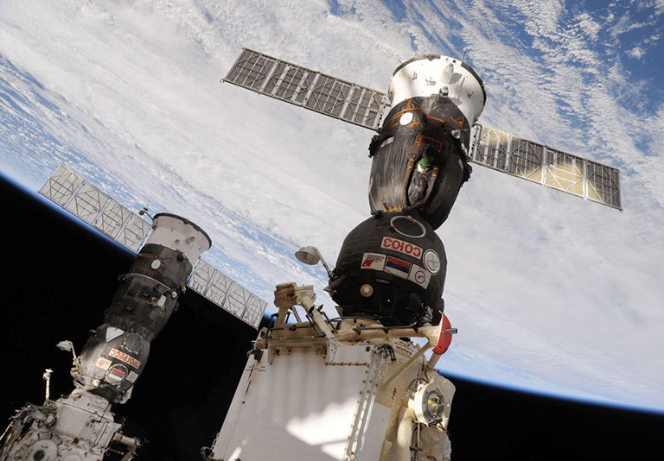
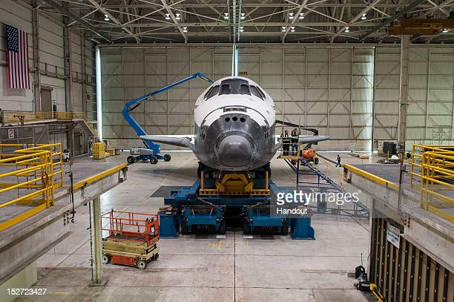
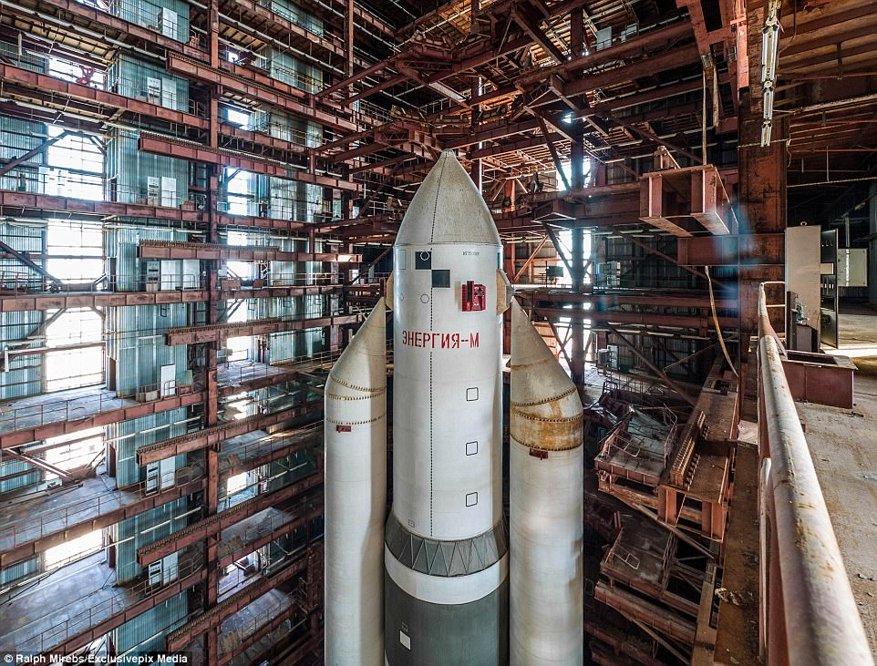
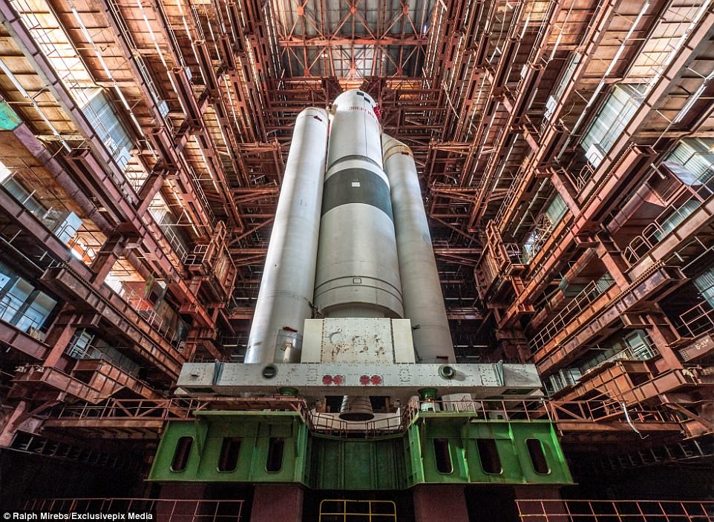
Space race
What is it
The player will be incuntroll of a test pilot from easa.
The starting level will be cheking a proto type before its first orbital flhitel.
the game will have a small space stashon in loure but wont apeare in the demo
The events of the game take place when the international space stashon has finished its mission and esa is making a chep whay to transport supplies and crew

Slide 2
Who will play this game
32 percent of gamers play simulaton games
The expectide adencve for this game
Will be fomiler with ksp and msfs.

Slide 3
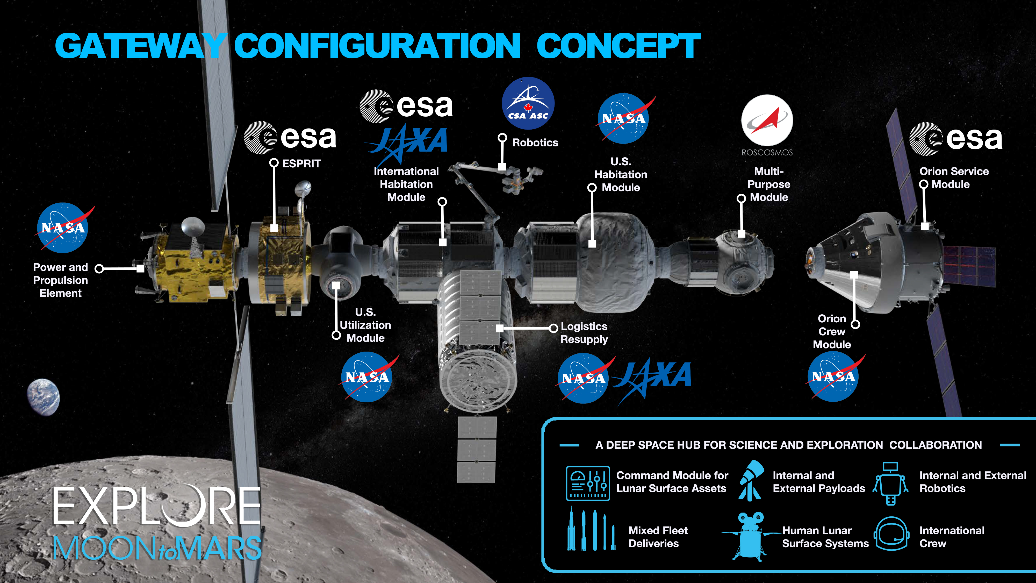
Whats happning in the game unerverse
The demo area will have the prototype being testid and finel tests until the flhite the craft will be siting in a vab of some sorts
Some more loure
Rusha and nasa continue to work togever after the iss hase finished
Esa is working whith idia and nasa to develop and improve the prototype. China have landed on the moon with the us and esa making and developing this craft to compeat with china. Space x has landed on mars and started developing a collny.
Space x wants and ssto like esa and nasa so hase started to fund the protype too.

Slide 4
What research will I have to do
I will have to reacherch arodynamics.
Intera dissine for unreal.

Slide 5
What do I see as the bigest chalinge to the progect
I think the bigist hurdel to the work will be the ritten worck in terms of getting it done and spelling.
The bigist chalinge with the practicle worck will be relearning lots of the sothetweare that we havent used scince lockdown.

Slide 6
Why have I chose this idea
I have a personal interest in space and what could happen in the futer of space flhite.

